Slide 1
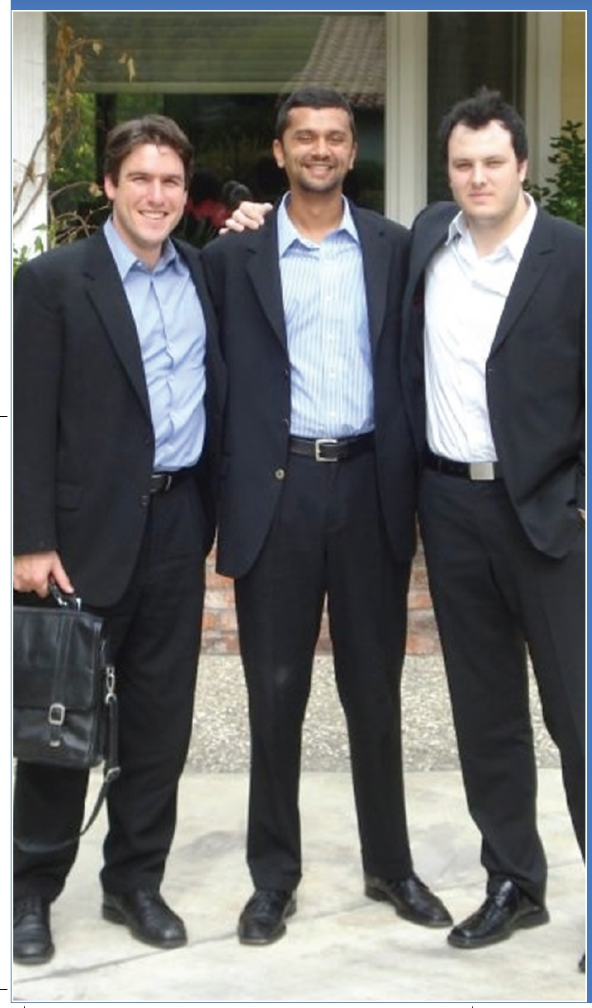
Chapter 9
Building a New-Venture Team
Bruce R. Barringer
R. Duane Ireland
Copyright ©2012 Pearson Education, Inc. publishing as Prentice Hall
9-<number>

Slide 2
Chapter Objectives
1 of 2
Identify the primary elements of a new-venture team.
Explain the term liabilities of newness.
Discuss the difference between heterogeneous and homogenous founding teams.
Identify the personal attributes that strengthen a founder's chances of successfully launching an entrepreneurial venture.
Describe how to construct a “skills profile,” and explain how it helps a start-up identify gaps in its new-venture team.
Copyright ©2012 Pearson Education, Inc. publishing as Prentice Hall
9-<number>

Slide 3
Chapter Objectives
2 of 2
Describe a board of directors and explain the difference between inside directors and outside directors.
Identify the two primary ways in which the nonemployee members of a start-up’s new-venture team help the firm.
Describe the concept of signaling and explain why it’s important.
Discuss the purpose of forming an advisory board.
Explain why new venture firms use consultants for help and advice.
Copyright ©2012 Pearson Education, Inc. publishing as Prentice Hall
9-<number>

Slide 4
New-Venture Team
New-Venture Team
  Is the group of founders, key employees, and advisors that move a new venture from an idea to a fully functioning firm.
  Usually, the team doesn’t come together all at once. Instead, it is built as the new firm can afford to hire additional personnel.
  The team also involves more than paid employees.
    Many firms have boards of directors, boards of advisors, and professionals on whom they rely for direction and advice.
Copyright ©2012 Pearson Education, Inc. publishing as Prentice Hall
9-<number>

Slide 5
Liabilities of Newness
New ventures have a high propensity to
fail.
The high failure rate is due in part to
liabilities of newness, which refers to the
fact that new companies often falter
because the people involved can’t adjust
fast enough to their new roles and because
the firm lacks a track record of success.
Assembling a talented and experienced
management team is one path that firms
can take to overcome these limitations.
Liabilities of Newness
Copyright ©2012 Pearson Education, Inc. publishing as Prentice Hall
9-<number>

Slide 6
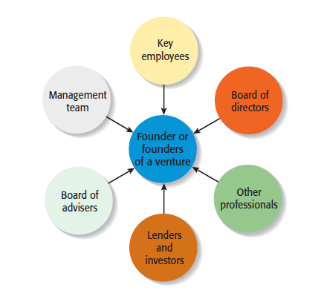
Separate Elements of a New-Venture Team
Copyright ©2012 Pearson Education, Inc. publishing as Prentice Hall
9-<number>

Slide 7
The Founder or Founders
Founder or Founders
  The characteristics of the founder or founders of a firm and their early decisions have a significant impact on the manner in which the new-venture team takes shape.
Size of the Founding Team
  Studies have shown that 50% to 70% of all new ventures are started by more than one individual.
  Experts disagree about whether new ventures started by a team have an advantage over those started by a sole entrepreneur.
Copyright ©2012 Pearson Education, Inc. publishing as Prentice Hall
9-<number>

Slide 8
Advantages and Disadvantages of Starting a Venture as a Team
1 of 2
Advantages
  Teams bring more talent, resources, and ideas to a new venture.
  Teams bring a broader and deeper network of social and professional contacts to a new business.
  The psychological support that the cofounders of a business can offer one another can be an important element of a new venture’s success.
Copyright ©2012 Pearson Education, Inc. publishing as Prentice Hall
9-<number>

Slide 9
Advantages and Disadvantages of Starting a Venture as a Team
2 of 2
Disadvantages
  Team members may not get along.
  If two or more people start a firm as “equals,” conflicts can arise when the firm needs to establish a formal structure and designate one person as the CEO.
  If the founders have similar areas of expertise, they may duplicate rather than complement one another.
  Team members can easily disagree in terms of work habits, tolerances for risk, levels of passion for the business, ideas on how the business should be run, and similar key issues.
Copyright ©2012 Pearson Education, Inc. publishing as Prentice Hall
9-<number>

Slide 10

Key Element of a Successful Founding Team
Heterogeneous rather than
homogenous teams tend
to be more effective.
This team is starting an
educational software
company.
The woman on the left is
a former teacher, the
woman in the middle is a
software engineer, and the
man on the right has a
business background.
Copyright ©2012 Pearson Education, Inc. publishing as Prentice Hall
9-<number>

Slide 11
Preferred Attributes of Sole Entrepreneurs and Members of a New-Venture Team
Higher Education
  Evidence suggest that important entrepreneurial skills are enhanced through higher education
Prior Entrepreneurial Experience
  Founders familiar with the entrepreneurial process are more likely to avoid costly mistakes than founders without similar experience.
Copyright ©2012 Pearson Education, Inc. publishing as Prentice Hall
9-<number>

Slide 12
Factors that Contribute to a Founder or Founders’ Success
Relevant Industry Experience
  Founders with relevant industry experience are more likely to have:
    Better established professional networks
    More applicable marketing and management skills
Broad Social and Professional Network
  Founders with broad social and professional networks have potential access to additional know-how, capital, and customer referrals.
Copyright ©2012 Pearson Education, Inc. publishing as Prentice Hall
9-<number>

Slide 13
Recruiting and Selecting Key Employees
Recruiting Key Employees
  Start-ups vary in terms of how quickly they need to add personnel.
  In some instances, the founders will work alone for a period of time. In other instances, employees are hired immediately.
  A skills profile is a chart that depicts the most important skills that are needed and where skills gaps exist in a new firm.
Copyright ©2012 Pearson Education, Inc. publishing as Prentice Hall
9-<number>

Slide 14
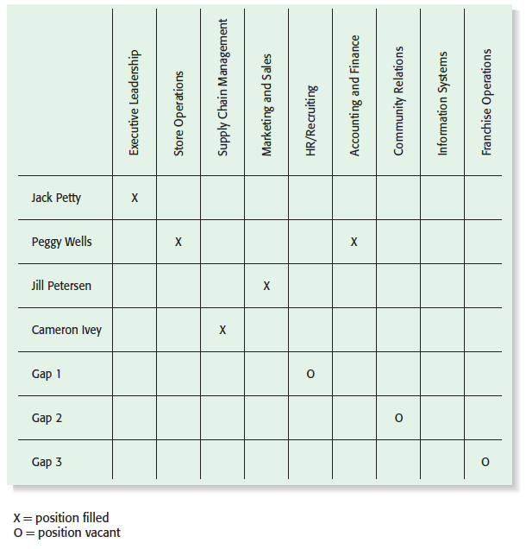
Skills Profile for New Venture Fitness Drinks
Copyright ©2012 Pearson Education, Inc. publishing as Prentice Hall
9-<number>

Slide 15
The Roles of the Board of the Directors
1 of 2
Board of Directors
  If a new venture organizes as a corporation, it is legally required to have a board of directors.
  A board of directors is a panel of individuals who are elected by a corporation’s shareholders to oversee the management of the firm.
  A board is typically made up of both inside directors and outside directors.
    An inside director is a person who is also an officer of the firm.
    An outside director is someone who is not employed by the firm.
Copyright ©2012 Pearson Education, Inc. publishing as Prentice Hall
9-<number>

Slide 16
The Roles of the Board of the Directors
2 of 2
Formal Responsibility of the Board
  A board of directors has three formal responsibilities.
    Appoint the officers of the firm.
    Declare dividends.
    Oversee the affairs of the corporation.
Frequency of Meetings and Compensation
  Most boards of directors meet three to four times a year.
  New ventures are more likely to pay their board members in company stock or ask them to serve on a voluntary basis rather than pay a cash honorarium.
Copyright ©2012 Pearson Education, Inc. publishing as Prentice Hall
9-<number>

Slide 17
What a Board of Directors Can Do to Help a Start-Up Get Off to a Good Start
Function
Importance of Function
Although a board of directors has formal governance responsibilities, its most useful role is to provide guidance and support to the firm’s managers.
Provide Guidance
Another function of a board of directors is to lend legitimacy to a firm. Well-known and respected board members bring instant credibility to a firm.
Lend Legitimacy
Copyright ©2012 Pearson Education, Inc. publishing as Prentice Hall
9-<number>

Slide 18
Rounding out the Team: The Role of Professional Advisors
Board of Advisors
Lenders and Investors
Other Professionals
Copyright ©2012 Pearson Education, Inc. publishing as Prentice Hall
9-<number>

Slide 19
Board of Advisors
1 of 3
Board of Advisors
  A board of advisors is a panel of experts who are asked by a firm’s managers to provide counsel and advice on an ongoing basis.
  Unlike a board of directors, an advisory board possesses no legal responsibility for the firm and gives nonbinding advice.
  An advisory board can be established for general purposes or can be set up to address a specific issue or need.
Copyright ©2012 Pearson Education, Inc. publishing as Prentice Hall
9-<number>

Slide 20
Board of Advisors
2 of 3
Board of Advisors (continued)
  Many people are more willing to serve on a company’s board of advisors than its board of directors because it requires less time and there is no potential legal liability involved.
  Like the members of a board of directors, the members of a company’s board of advisors provide guidance and lend credibility to the firm.
Copyright ©2012 Pearson Education, Inc. publishing as Prentice Hall
9-<number>

Slide 21
Board of Advisors
3 of 3
Guidelines to Organizing a Board of Advisors
  Advisors will become disillusioned if they don’t play a meaningful role in the firm’s development and growth.
  A firm should look for board members who are compatible and complement one another in terms of experience and expertise.
  When inviting people to serve on its board of advisors, a company should carefully spell out to the individuals involved the rules in terms of access to confidential information.
Copyright ©2012 Pearson Education, Inc. publishing as Prentice Hall
9-<number>

Slide 22
Lenders and Investors
Lenders and Investors
  Lenders and investors have a vested interest in the companies they finance, often causing them to become very involved in helping the firms they fund.
  Like the other non-employee members of a firm’s new-venture team, lenders and investors help new firms by providing guidance and lending advice.
  In addition, a firm’s lenders and investors assume the natural role of providing financial oversight.
Copyright ©2012 Pearson Education, Inc. publishing as Prentice Hall
9-<number>

Slide 23
Ways Lenders and Investors Add Value to an Entrepreneurial Firm
1 of 2
Provide insight into the markets that the new venture plans to enter
Help identify and recruit key management personnel
Help the venture fine-tune its business model
Serve as a sounding board for new ideas
Serve on the new venture’s board of directors or board of advisors
Provide introductions to additional sources of capital
Copyright ©2012 Pearson Education, Inc. publishing as Prentice Hall
9-<number>

Slide 24
Ways Lenders and Investors Add Value to an Entrepreneurial Firm
2 of 2
Help to arrange business partnerships
Recruit customers
Serve on the board of directors or board of advisors
Provide a sense of stability and calm
Copyright ©2012 Pearson Education, Inc. publishing as Prentice Hall
9-<number>

Slide 25
Other Professionals
Other Professionals
  The other professionals that make up a firm’s new-venture team include attorneys, accountants, and business consultants.
Business Consultants
  A business consultant is an individual who gives professional or expert advice.
  Business consultants fall into two categories: paid consultants and consultants who are available for free or at a reduced rate through a nonprofit or governmental agency.
Copyright ©2012 Pearson Education, Inc. publishing as Prentice Hall
9-<number>

Slide 26

All rights reserved. No part of this publication may be reproduced, stored in a retrieval system, or transmitted, in any form or by any means, electronic, mechanical, photocopying, recording, or otherwise, without the prior written permission of the publisher. Printed in the United States of America.
Copyright ©2012 Pearson Education, Inc. publishing as Prentice Hall
Copyright ©2012 Pearson Education, Inc. publishing as Prentice Hall
9-<number>

